Slide 1
How HOT is FHIR?
Come find out!
Fast, Modern, Implementer-friendly
80+ FHIR-related quarters this week
See the complete list on the wiki:
http://wiki.hl7.org?title=FHIR_Agenda_201409_WGM
Check out the specification
http://hl7.org/fhir

Slide 2
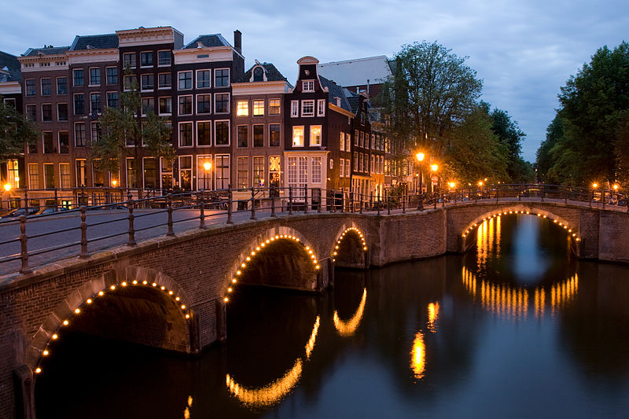






International HL7 FHIR Developer Days November 24-26, 2014 in Amsterdam
Education
14 tutorials
pick & choose
Connectathon
Meet fellow developers
Put FHIR to the test
Networking
FHIR experts and authors on hand
http://fhir.furore.com/devdays

